Slide 1

Harness Engineering
Building the Execution Infrastructure for Autonomous AI Agents
Agent = Foundation Model + Harness Infrastructure • From Stochastic Prompts to Reliable Systems

Slide 2


Agenda
What we'll cover in this session
01
Why Harness Engineering Matters
02
Anatomy & Evolution of an Agent Harness
03
PowerSpine: ISG's Standard Harness
04
Core Harness Control Patterns
05
Harness Engineering & Spec-Driven Development
06
Harness in Practice: Adoption Across ISG
07
Key Takeaways

Slide 3

Harness
The engineered infrastructure of guides, sensors, guardrails, and sandboxes built around a model to make its behavior reliable, safe, and repeatable.

Slide 4
Agent = Harness + LLM
An agent is a model's reasoning wrapped in a harness that steers, checks, and constrains it — intelligence alone isn't an agent.

Slide 5
Spec-Driven Development
Define the spec and Definition of Done first, then generate and verify code against it — not the other way around.

Slide 6
The Anatomy & Evolution
Why raw model intelligence converges across providers while harness quality determines real-world production reliability.

Slide 7





Anatomy of an Agent Harness
OUTER LAYER: SAFETY, GATEWAYS & MONITORING (HITL / TELEMETRY / AUDIT LOGS)
MIDDLE LAYER: CONTROL LOOP & EXECUTION SANDBOX
Memory & State
Tool Sandbox
Guardrails
Feedback Evaluator
Compaction, session history & storage
Isolated micro-VMs & CLI execution
Schema validation & rate limits
AST checks, linters & unit tests
Foundation Model Core (LLM / Reasoning Engine)
Stateless Predictor: Receives hydrated prompt context $\rightarrow$ Generates intent / tool invocation

Slide 8
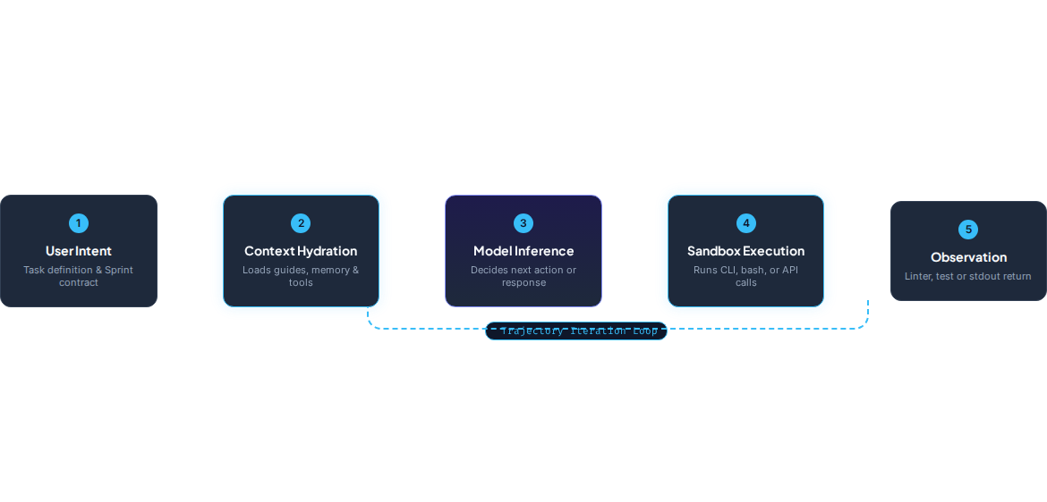
The Execution Control Loop

Slide 9




Evolution of Harness Engineering
2026+: Harness Systems
2023-24: Context Eng
Complete execution envelopes: Micro-VM sandboxes, context compaction, deterministic feedback.
RAG pipelines, vector stores, and simple function calling hooks.
2022: Prompting
2025: Agentic Loops
Static system prompts and isolated text generation completions.
ReAct loops, basic multi-agent handoffs, and basic memory state.

Slide 10
PowerSpine: One AI Development Approach for ISG
A message from Arthur Lewis — unifying Spec-Driven Development across ISG with one central harness and federated edges.
PowerSpine: The Central Harness
The Operating Model Behind It
One standard harness, built for every team to build on
Built to scale responsibly across ISG
One Central Harness, Federated Edges
Centralized + Embedded Agent Ops
PowerSpine sets the ISG-wide standard for Spec-Driven Development, while federated edges let every product and engineering team adapt and innovate within that framework.
A new centralized Agent Ops team is complemented by Agent Ops teams embedded directly in product and engineering.
/spine Central: Unified Portal
Data Strategy & Governance
Launched today — one portal for spec management, observability, and pipeline status across ISG. Live for R&D now; explore it and share feedback.
More structure is forming around data strategy and governance as these teams stand up — creating new opportunities across ISG.
Speed AND Quality, Not a Trade-off
Onboarding Across ISG
Moving the quality gate upstream means fewer surprises mid-flight — this transformation asks us to achieve both, not choose.
More teams and products join over the coming weeks, extending consistent visibility across the full Spec-Driven Development lifecycle.

Slide 11
Why It Matters: Early Results Across ISG
Real outcomes from teams already building on Spec-Driven Development
UDS: 7x Faster Delivery
Polaris: 20 → 10 Months
UDS is shipping net-new features 7x faster — with fewer defects at release.
The Polaris team cut its delivery timeline in half by moving the quality gate upstream.
DPC Pod: 101 Features / 8 Weeks
UDS: +80% Contributions
A five-person DPC pod shipped the first ISG release built entirely on Spec-Driven Development.
The UDS team saw an 80% increase in contributions under Spec-Driven Development.
“This transformation doesn’t ask us to trade speed for quality and security. It asks us to achieve both.”
— Arthur Lewis

Slide 12
Why These Comparisons Matter
A harness is a set of controls layered around a model. The next few slides walk through the two families of controls that make those layers concrete — and why both are necessary, not optional.
Computational Controls
Memory Controls
Feedforward vs. Feedback: whether the harness steers behavior before the model acts, or evaluates and corrects it after — and why real harnesses need both.
Context Compaction vs. Tool Offloading: how a harness manages a model's limited attention budget over a long-running task, instead of letting context rot.
Together, these four mechanisms are what separate a harness that merely runs from one you can trust.

Slide 13
Feedforward vs. Feedback Controls
Feedforward Controls (Guides)
Feedback Controls (Sensors)
Steers behavior before model invocation
Evaluates output after tool execution
AGENTS.md & Repository Architecture Guides
Deterministic AST & Linter Feeds
Informs the agent of workspace rules, style guidelines, and design boundaries.
Formats static analyzer & syntax compiler errors directly into prompt feedback.
Progressive Tool Disclosure
Automated Test Execution Suites
Dynamically restricts tool schemas to prevent context bloating and hallucination.
Runs automated unit/integration tests in sandboxes to verify functionality.
Evaluator-Agent Verification Loops
Upfront Sprint Contracts
De-couples generation from evaluation using independent LLM reviewer roles.
Negotiates strict "Definition of Done" acceptance criteria before generating code.

Slide 14


Context Compaction & Tool Offloading
Raw Unmanaged Trajectory
Harness-Managed Context
Token budget exhaustion & reasoning degradation
Preserves attention & focus on critical task state
Harness Compaction

Slide 15





Human-in-the-Loop & Safety Fallbacks
Proposed Tool Action Evaluation
Low-Risk / Read-Only
High-Risk Operations
Execution Failure
Automated Sandbox Execution. Runs file reads, local tests, and code analysis without pause.
HITL Gate Intercept. Mandates human verification before DB writes or infra mutations.
Graceful Error Recovery. Harness captures stack trace and prompts self-correction loop.

Slide 16
Computational vs. Inferential Controls
Control Dimension | Computational Controls (CPU / Static) | Inferential Controls (GPU / LLM)
Primary Mechanism | Static analysis, linters, AST validation, unit tests | LLM-as-a-Judge, evaluator agents, semantic review
Execution Speed | Milliseconds (Instant execution feedback) | Seconds to minutes (Inference overhead)
Determinism | 100% deterministic & repeatable pass/fail signals | Probabilistic, non-deterministic semantic judgment
Token & Cost Impact | Zero LLM token consumption, low resource cost | Consumes context window & inference API budget

Slide 17
The Spectrum of Agent Control
Naked Model Prompt
Prompt Wrappers + RAG
Basic ReAct Tool Loop
Full Harness Infrastructure

Slide 18
Core Harness Architectural Patterns
Sprint Contracts: Formal acceptance criteria negotiated between generator and evaluator before code generation starts.
Role-Split Architectures: Decouple Planner, Generator, and Evaluator into distinct isolated invocation contexts.
Ephemeral Sandboxing: Execute all terminal commands inside ephemeral micro-VMs or container sandboxes.
Aggressive Context Compaction: Automatically collapse historical execution logs into local file pointers and concise state summaries.

Slide 19
The Steering Loop Mindset
Anytime you find an agent makes a mistake, engineer a solution into the harness so that the agent never makes that mistake again.
"
"
— Mitchell Hashimoto

Slide 20
Harness Engineering & Spec-Driven Development
Spec-Driven Development is the practice; Harness Engineering is what makes it enforceable at scale.
Spec-Driven Development: The Methodology
Harness Engineering: The Infrastructure
What teams commit to doing
What makes the methodology enforceable
Define the Spec First
Guides Encode the Spec
Write the acceptance criteria and Definition of Done before any code is generated, not after.
Feedforward controls (AGENTS.md, Sprint Contracts) put the spec directly in front of the model before it generates.
Generate Against the Spec
Sensors & Evaluators Verify It
The model produces code aimed at a fixed target, instead of an open-ended, negotiable request.
Feedback controls (lint, tests, reviewer agents) check the output against that same spec automatically.
Sandboxes Make It Safe
Verify Systematically
Guardrails and ephemeral execution let verification run repeatedly without risking production.
Every change is checked against the spec's criteria before it ships, not just reviewed by eye.

Slide 21
Harness in Practice: Adoption Across ISG
How teams onboard to PowerSpine and organize around it
Pod Construction
Federated Edges
Small cross-functional pods (developer, tester, reviewer, ops) mirror the harness's own role-split architecture.
Each product team adapts the shared harness to its own stack instead of forking a new one.
/spine Central
Agent Ops: Central + Embedded
One portal for spec management, observability, and pipeline status across every onboarded team.
A centralized team sets the standard; embedded Agent Ops in each product group applies it day to day.

Slide 22
Key Takeaways
What to remember, and what to do next
Use It. Improve It.
The Anatomy Is Concrete
Explore /spine central, adopt it in your federated edge, and share feedback — the team is iterating.
Guides, Sensors, Feedback Loops, Sandboxes, and Guardrails aren't abstract — they're the exact controls inside PowerSpine today.
Harnesses Determine Reliability
PowerSpine Already Works
Not raw model intelligence — the guides, sensors, and guardrails around it are what make agents production-ready.
DPC, Polaris, and UDS prove the model: same harness, faster delivery, fewer defects.

Slide 23
Architecting the Future
Models provide reasoning intelligence. Harness Engineering provides systems reliability.
Questions & Discussion • Software Engineering in the Agentic Era

Slide 24
Live Demo
Watching a harness evolve, one control at a time
01
Model only — no controls, confidently wrong
02
Guide + Sensor + feedback loop — the model self-corrects
03
Sandbox + Guardrails + Human-in-the-Loop — safe by construction

Slide 25
Questions & Discussion
What's working, what's not, and what do you need?
Share it with your leaders — that's how we get this right.

Slide 26
Thank You
Explore /spine central. Build within your federated edge. Embrace the harness.
Harness Engineering • Software Engineering in the Agentic Era

